Slide 1
Environment of an Organization, Social Responsibility, and Ethics
Session 4

Slide 2
Definition of Environment of an Organization
The organizational environment is the set of forces surrounding an organization that have the potential to affect the way it operates. Scholars have Divided these environmental factors into two main parts as,
Internal environment
External environment

Slide 3
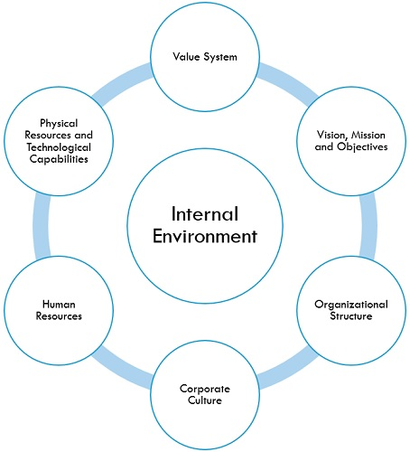
Internal environment

Slide 4
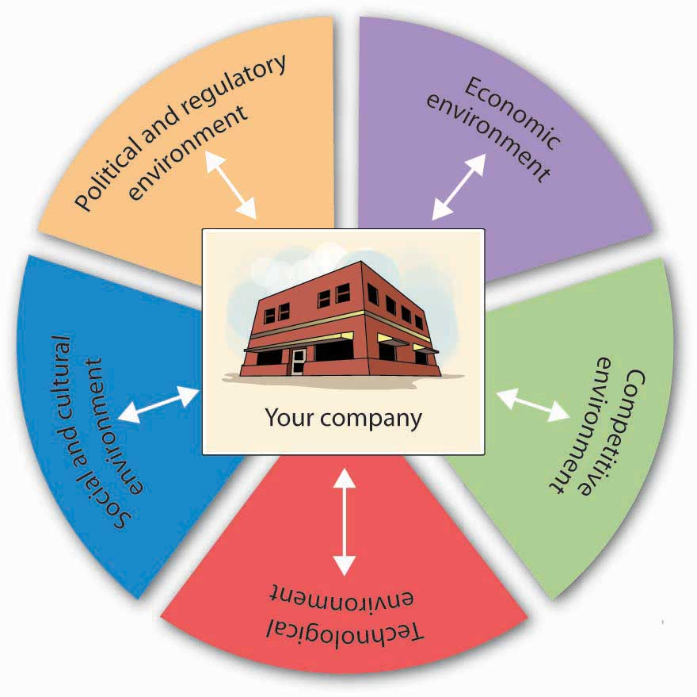
External Environment
In addition to this we have Ecological environment

Slide 5
Political and Legal Environment
Legislature(Parliament and assembly)-Law making body
Executive(Government)-Law implementing body
Judiciary
Articles in constitution:
Article 14-Guarantees equality before law
Article 15-Prohibits Discrimination
Article 23-Prohibits forced labor

Slide 6
Economic environment
All businesses, whether domestic or international, are affected by the dynamic economic environment conditions prevalent in the market. Among many economic factors affecting business some are; interest rates, demand and supply, recession, inflation, etc.

Slide 7
Competitive environment
Nearly every work environment is a competitive environment.
The primary source of the competition can vary from one work area to another, but there's competition from other local or area firms, from out-of-state firms and from companies located all over the world.
Competition can emerge seemingly from nowhere, with the emergence of new products that replace current products with more desirable products or with products that provide the same benefits at dramatically lower costs.

Slide 8
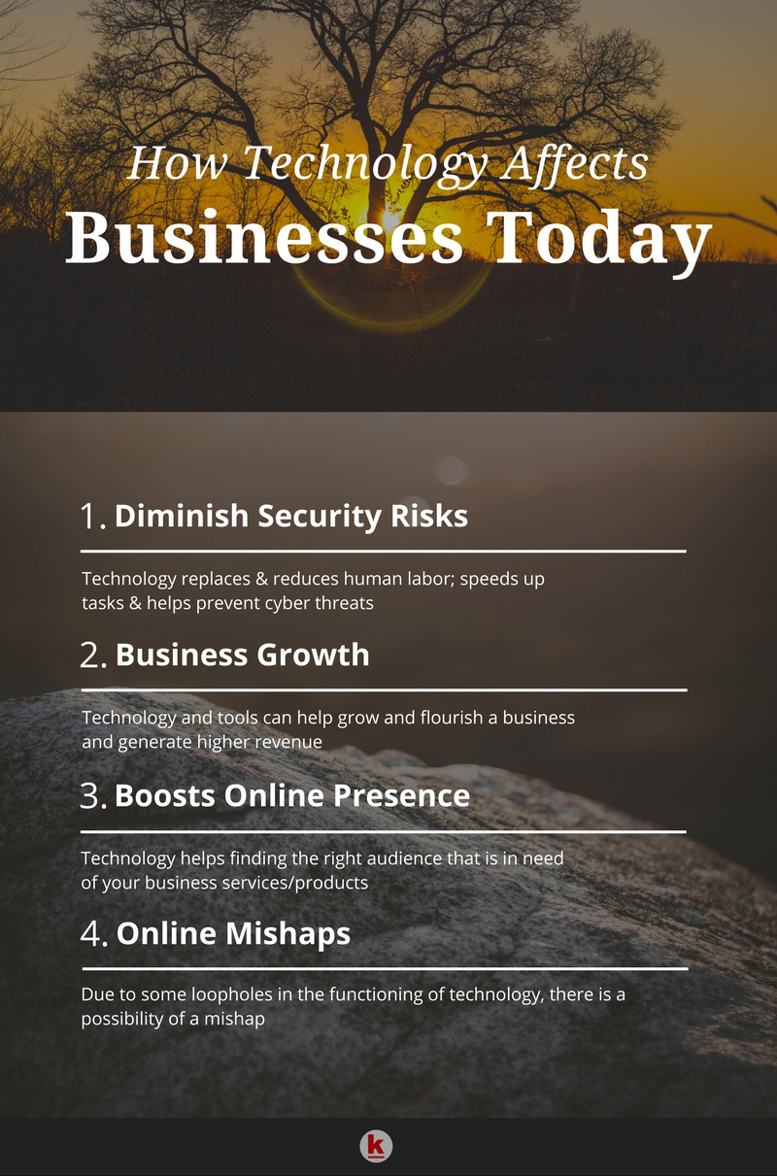
Technological factors

Slide 9
Socio-Cultural factors
The buying and consumption habits of the people,
their language,
beliefs and values,
customs and traditions,
tastes and preferences,
Health consciousness
education are all factors that affect business

Slide 10
Ecological factors
Environmental Policies
Climate change
Green agenda
Pollution
Availability of natural resources
Recycling
Waste disposal

Slide 11
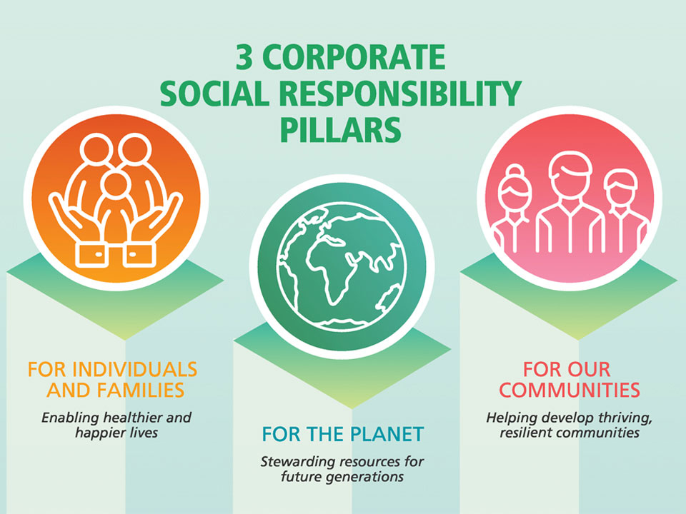
The Social Responsibility of Managers
Corporate Social Responsibility is a management concept whereby companies integrate social and environmental concerns in their business operations.

Slide 12
Potential business benefits
Triple bottom line
Human Resources
Risk management
Brand differentiation
Reduced scrutiny
Supplier relations
Crisis management

Slide 13

Ethics in Managing

Slide 14
Unethical business practices
Misleading product information
Unfair competition
Mistreating employees
Manipulating accounts
Bribery

Slide 15


